Slide 1


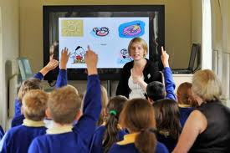

How Technology is Infused
in the
Schools of England.

Slide 2

England’s technology education
Design and Technology
Information and Communication Technology
Resistant materials
Graphic products
Textiles
Food technology
Electronics
Word processing
Graphics
Computer Aided Design
Desk Top
Publishing Spreadsheets

Slide 3

Technology in England’s Education System
The Home Access Taskforce, set up by the Government last year (January 2008), saw £300 million spent on providing computers and broadband internet access to families so that children can enhance their learning at home.
Computers for Pupils - a two year, £60 million program - will provide home ICT access to the most disadvantaged secondary pupils in the most deprived areas. By September 2010, all secondary schools will be expected to offer parents real-time access to information covering achievement, progress, attendance, behavior and special needs, and where it is appropriate, secure online access.

Slide 4

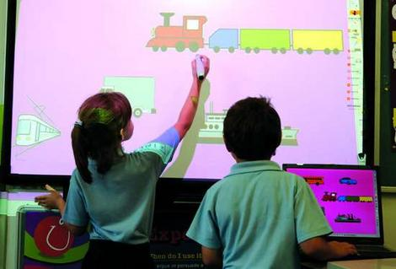
Instilling technology through:
Interactive White board

Slide 5
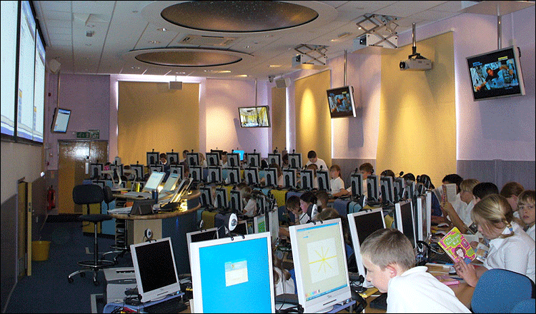
Desktop Computer

Slide 6
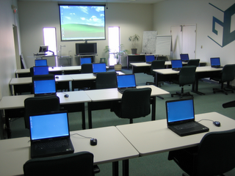
Laptop Computer

Slide 7

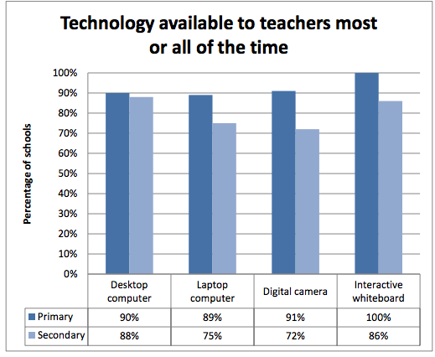

Slide 8
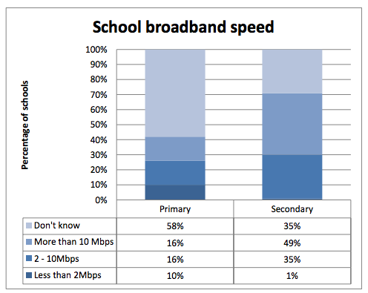

Slide 9



Infusing technology in Primary
School:

Slide 10

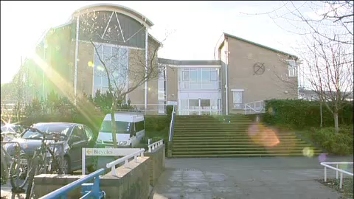
Infusing technology in Secondary
School:

Slide 11
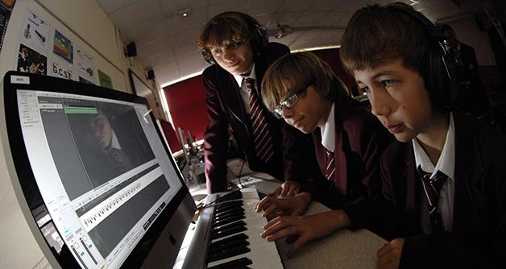
England’s Technology in Education
The number of computers used in education settings has risen dramatically--from an average of one per school in the early 1980s to several per classroom in 2002
A minimal requirement to use computer technology, in the first version of this curriculum, has since expanded to call for computer use across subject disciplines and, in recent years, use of the Internet to access subject knowledge.

Slide 12
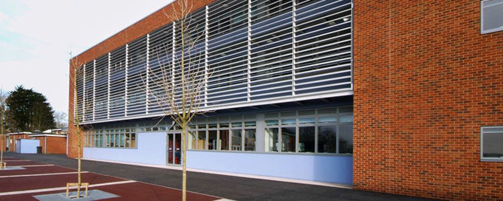
Wildern School
(Located in a suburb just outside Southampton, England)

Slide 13
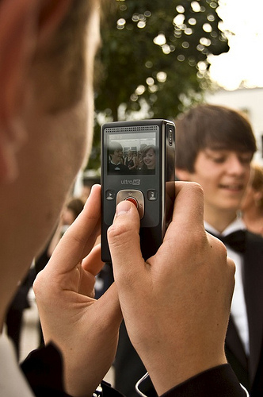
Bring Your Own Device (BYOD)
Students may bring their own devices in as long as the teacher and head of department concerned have agreed that phones and other devices would be useful in a particular lesson.

Slide 14
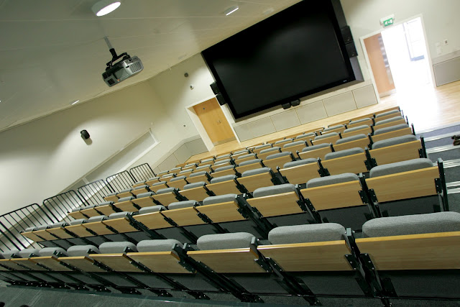
Genius Bar
teachers and students can borrow additional devices
Staff ICT School Improvement Group which was also involved in trials of certain tools, and provides the lead in each department for use of technology in lesson, and has also been making short films about how they are using the devices to enhance learning

Slide 15
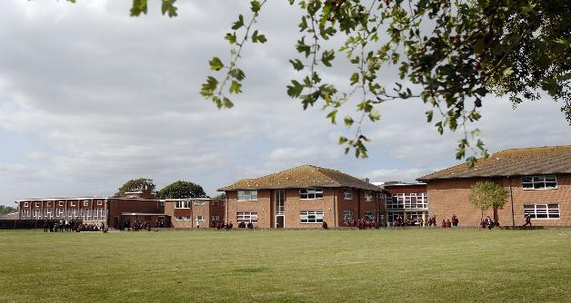
Arnewood School Academy
New Forest town of New Milton, in Hampshire, England

Slide 16
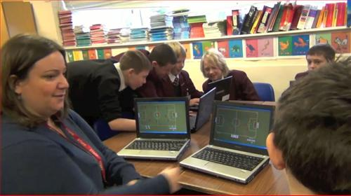
has a scheme which ensures that all students have a laptop
the staff has normalized the use of the digital in their everyday teaching
gives all students access to the school’s ICT facilities throughout the day, including at breakfast time and after school
has a reserve stock of equipment for daily use at school

Slide 17

Bibliography:
http://www.educationimpact.net/media/23170/bett-2011-a%20guide
%20to%20ict%20in%20the%20uk%20education%20system.pdf
http://www.insidegovernment.co.uk/children/ict/ index.php
http://www.questia.com/library/1G1-104520645/integrating-new- technologies-in-uk-classrooms-lessons
http://www.ictineducation.org/home-page/2012/11/30/byod-case- study-wildern-school.html
http://www.ictineducation.org/home-page/2012/11/22/byod-case- study-the-arnewood-school-academy.html

